Slide 1
.NET Aspire extensibility
Mitch Denny

Slide 2
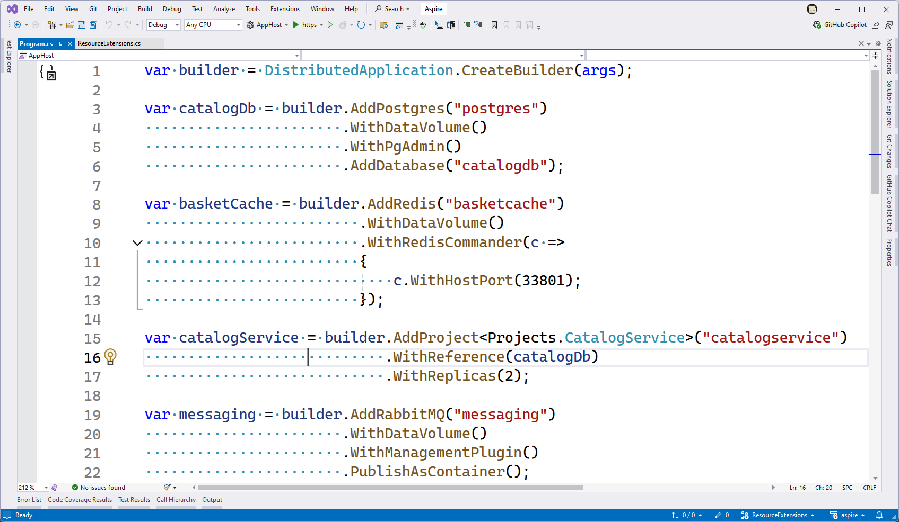

Slide 3
“Layers”

Slide 4
IDE
Dashboard
AppHost.exe (AppHost)
Extensions
Application Model
Developer Control Plane
Local Processes
Container
Runtime
Containers
Local Processes
Containers

Slide 6
.NET Aspire is built upon a small number of key concepts.

Slide 7

Demo: Builds, resources, and annotations
Mitch Denny

Slide 8
Demo: Building a hosting extension
Mitch Denny

Slide 9
Demo: Using lifecycle hooks
Mitch Denny

Slide 10
Demo: Manifest generation and expressions
Mitch Denny

Slide 11
Thank-you!

Slide 12
Resources
https://learn.microsoft.com//dotnet/aspire/extensibility/custom-resources?tabs=windows
https://learn.microsoft.com/dotnet/aspire/extensibility/custom-component
Create custom resource types for .NET Aspire
Create custom .NET Aspire component
https://github.com/dotnet/aspire-samples
https://github.com/dotnet/eshop
.NET Aspire samples (incl. some extensions)
eShop Sample
https://github.com/dotnet/aspire
https://discord.com/channels/732297728826277939/759125320505884752
.NET Aspire main repo
.NET Aspire Discord channel
https://github.com/aspirant-project/aspirant
https://learn.microsoft.com//dotnet/api/?view=dotnet-aspire-8.0&preserve-view=true
Aspirant
API Reference

Slide 13
.NET Aspire Developers Day
Start your learning journey:
aka.ms/dotnetAspireDevDay/Collection

